Slide 1
TDD Workshop
Hands-on Project

Slide 2
Introduction to the Project

Slide 3
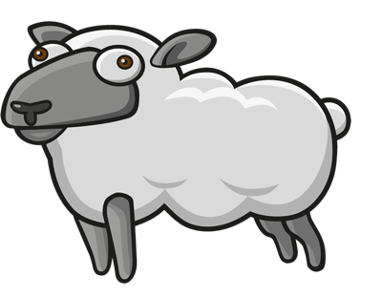
Welcome to “Sheeper”!
We are a scrappy startup that is totally not a Twitter knockoff. Our mission is to deliver the most innovative social network ever! Its gonna be huge.

Slide 4
Agenda
Learning about the state of the art Sheeper architecture and UX.
Implement the delete feature together
Break out into two-person teams and implement another feature – edit.

Slide 5
The Sheeper Site
Our website allows people to post short messages “bleets” ( bleats are the sound sheep make, but we spell it c0013r).
There is a SPA built with AngularJS that communicates with a backend written in NodeJS and Express.
The backend contains two micro services:
Bleet Service – Used to post, delete, edit, bleets.
User Service – Used to create, edit, delete suers.
More info on the API can be found here: https://github.com/francesco-desensi/tdd-workshop-angular-js/wiki/Sheeper-Api

Slide 6
Group Feature Implementation
Delete at Bleet

Slide 7
Getting started…
Add

Slide 8
Breakout

Slide 9
Your mission…
As a sheeper
I want the ability edit bleets
So that I can change the texts of bleets when I make mistakes and stuff.

Slide 10
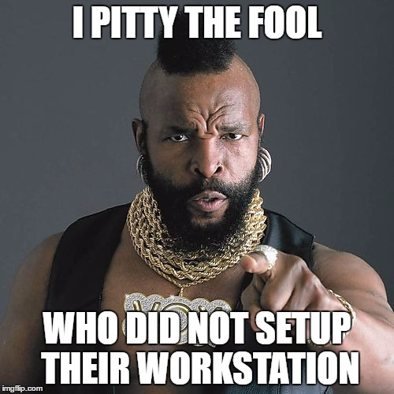
Workstation Setup
https://github.com/francesco-desensi/tdd-workshop-angular-js/wiki/workspace-setup

Slide 11
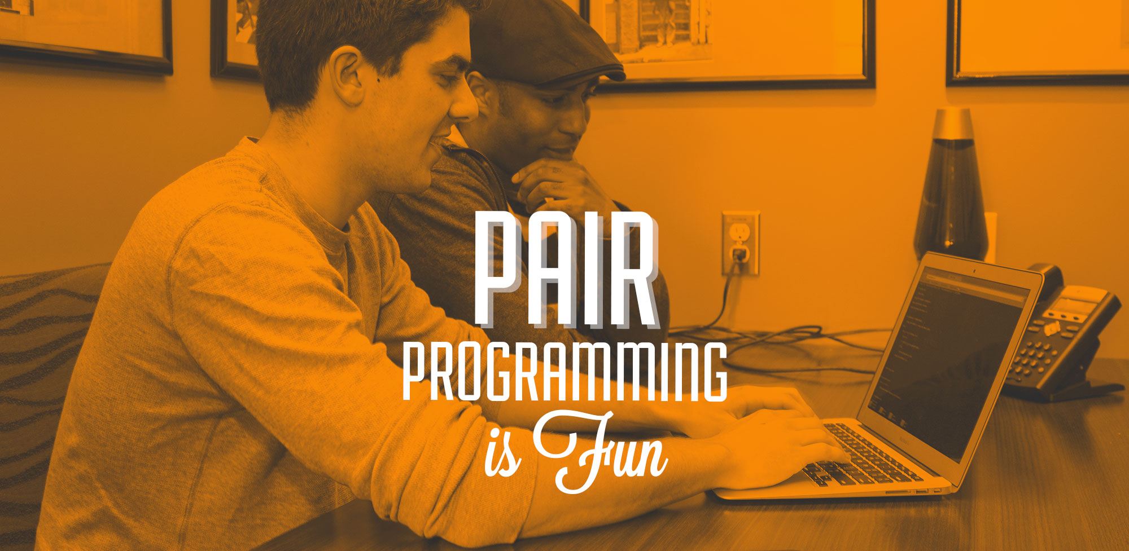
Get a partner

Slide 12
During the exercise…
Please try to practice the following TDD principles…
Always start with a test
Arrange
Act
Assert
Red/Green/Refactor
Make the test fail
Write the code
Make the test pass
Refactor
Repeat

